Slide 1
Global Population and Fertility Analysis
Group : 5
Avinash Cheetireala
Charan kumar changanaboina
Girish reddy madireddy
Pallavi Ravindra
Rakesh valluri

Slide 2
Overview:
The provided slide outlines an overview of the data used in this analysis. The datasets employed include Fertility Data by Country (sourced from the United Nations Fertility Data) and Population Data by Country (derived from the United Nations Population Data).
These datasets cover an extensive time period from 1950 to 2024, providing insights into fertility rates and population distribution by age group and gender across different countries such as India, China, and the USA.
Key features of the data include detailed fertility rates across countries, an analysis of population demographics by age and gender, and comprehensive country-level statistics, offering a robust foundation for evaluating trends and making data-driven conclusions.

Slide 3
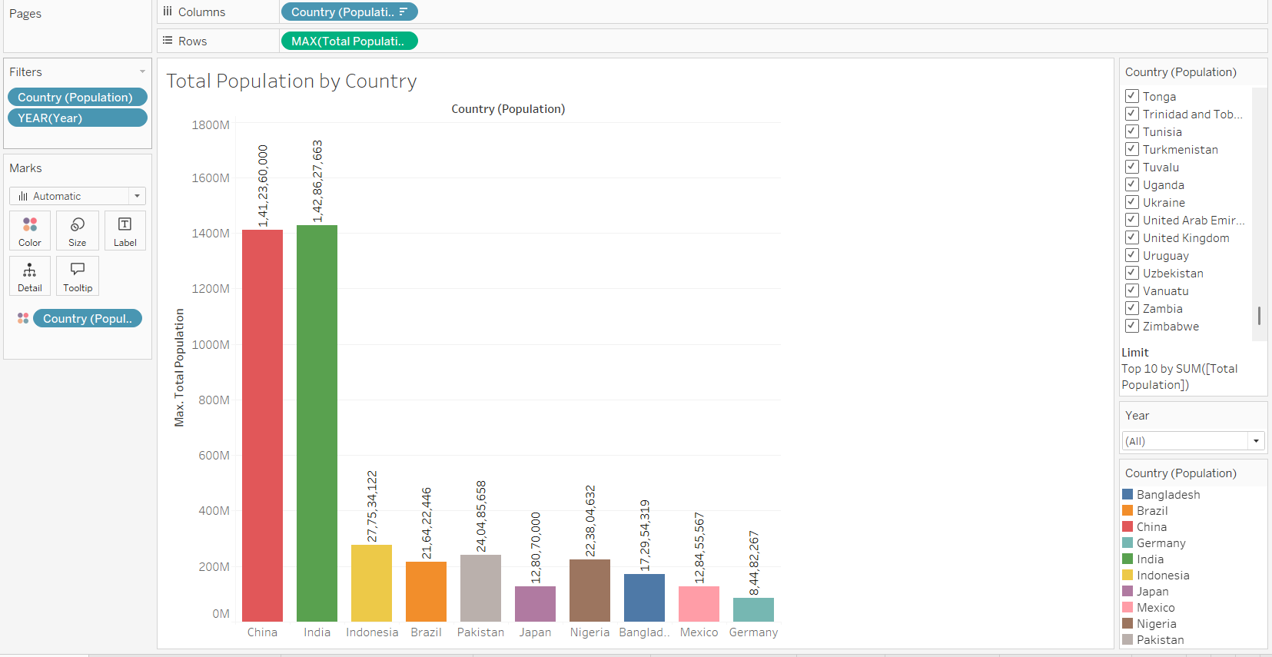
Population Distribution by Top 10 Countries
Key Findings:
- China and India each have populations exceeding 1.4 billion.
- These two countries dominate global population distribution.
- Other countries in the top 10 include Indonesia, Pakistan, and the United States.

Slide 4
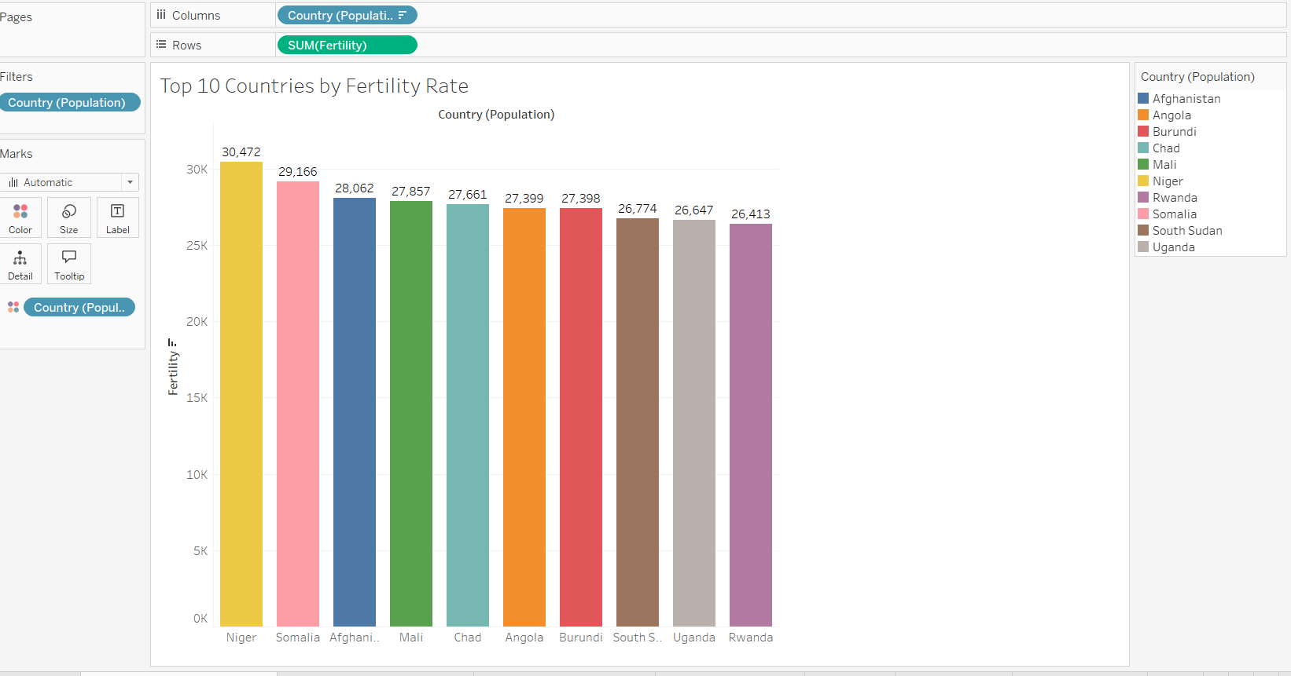
Top 10 Countries by Fertility Rate
Key Findings:
- Niger leads with the highest fertility rate globally.
- High fertility rates are concentrated in African countries.
- Socioeconomic factors like healthcare and education influence these rates.

Slide 5
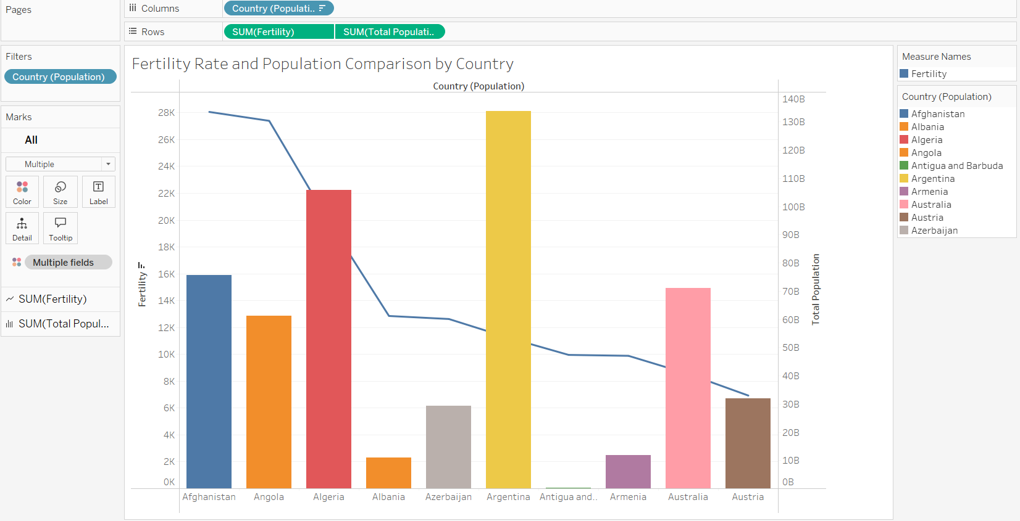
Fertility Rate and Population Comparison
Key Findings:
- High fertility rates do not always correlate with high population sizes.
- Countries with large populations tend to have lower fertility rates.
- Highlights the impact of economic and developmental factors.

Slide 6
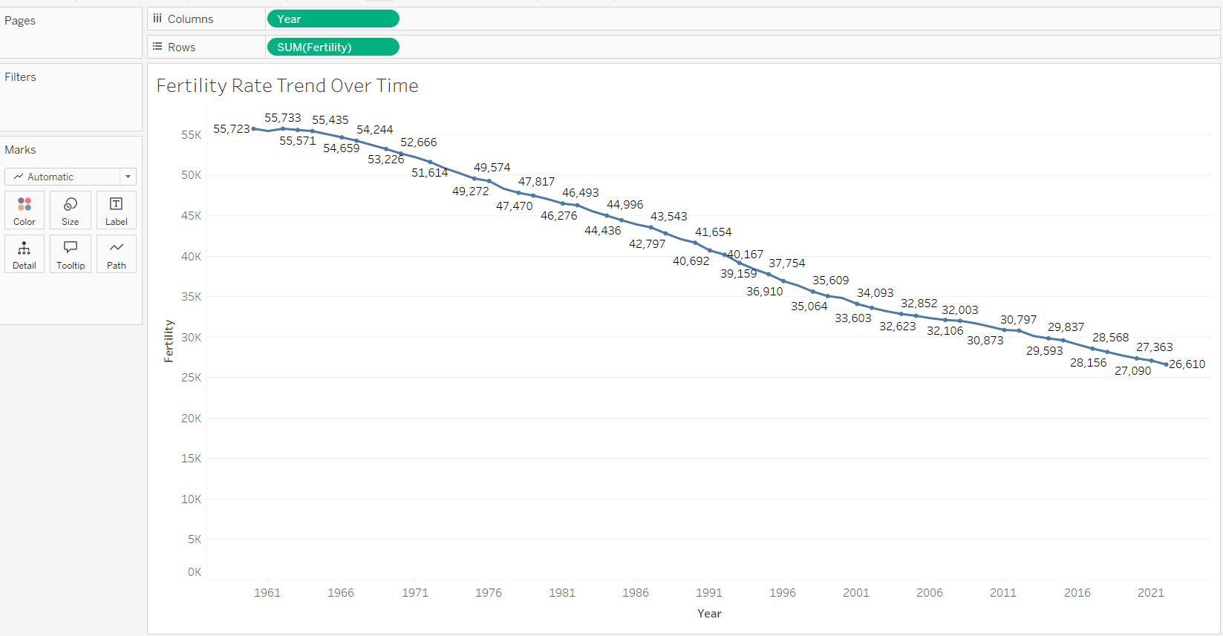
Fertility Rate Trend Over Time
Key Findings:
- Global fertility rates have shown a steady decline from 1960 to 2023.
- This trend indicates shifts toward smaller families and better family planning.
- Factors include improved education and healthcare access.

Slide 7
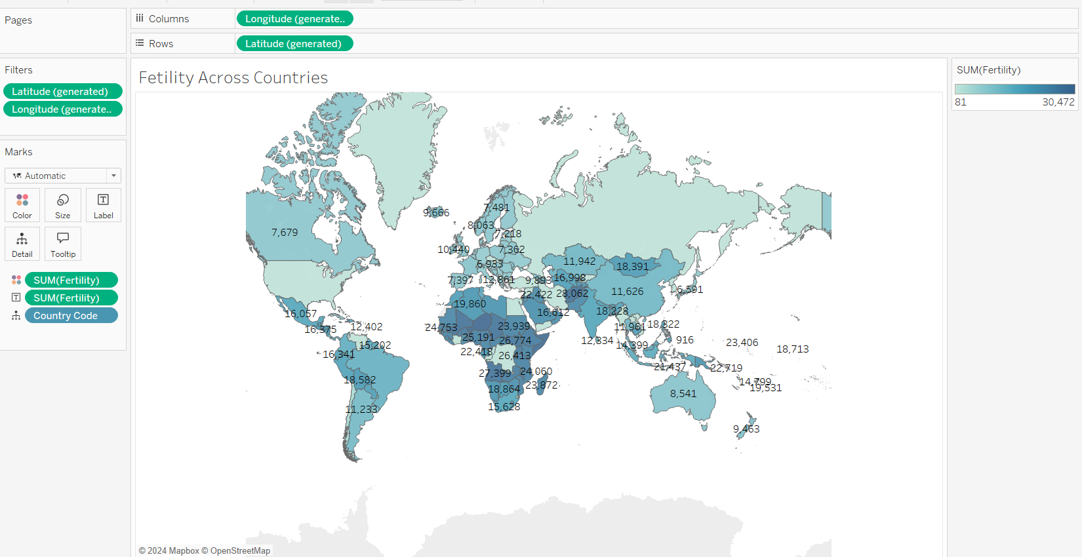
Fertility Across Countries
Key Findings:
- Fertility rates vary significantly across the globe.
- Africa shows the highest fertility rates, while Europe and North America are lower.
- These disparities highlight differences in development and demographics.

Slide 8
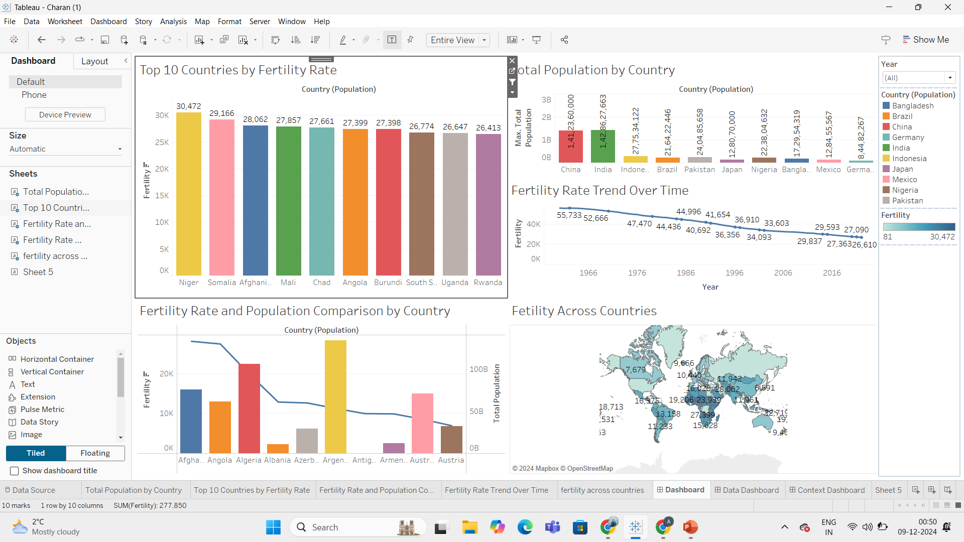
FINAL DASHBOARD

Slide 9
Conclusion:
The analysis of global fertility rates and population distribution has revealed significant insights into the changing demographics of the world. Fertility rates have shown a steady decline globally, reflecting shifts towards smaller families, advancements in healthcare, and improved access to education.
The data highlights stark regional differences, with countries in Africa and South Asia experiencing higher fertility rates and faster population growth, while developed regions such as Europe and East Asia face aging populations and declining fertility.
These trends underscore the importance of tailored policy interventions: countries with high fertility rates must prioritize investments in healthcare, education, and infrastructure to manage population growth sustainably, while countries with aging populations need strategies to address workforce shortages and economic challenges. Addressing these demographic shifts effectively will require global collaboration and region-specific approaches to ensure a balanced and prosperous future.

Slide 10


